Slide 1
Mohamed Shazly
Id:220159

Slide 2
Minimum Spanning Tree
Kruskal’s Algorithm

Slide 3
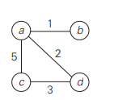
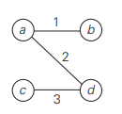
WHAT IS A SPANNING TREE?
A spanning tree is a subset of Graph G.
A spanning tree must be connected
A spanning tree must form 0 cycles.
Graph G
Spanning Tree of G

Slide 4
THE PROBLEM
Kruskal’s algorithm attempts to solve the problem of finding minimum spanning tree of an undirected graph with weighted edge. The primary goal of the algorithm is to find the tree that spans all the vertices with the minimum cost and forms 0 cycles.

Slide 5
THE STRATEGY
Kruskal’s algorithm uses greedy technique. It starts with an empty tree then appends the edges with minimum cost that doesn’t form a cycle the process continues until all vertices are included in the tree.

Slide 6
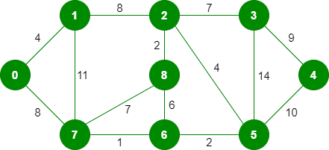

Slide 7
1ST STEP

Slide 8
2ND STEP

Slide 9
3RD STEP

Slide 10
4TH STEP

Slide 11
5TH STEP

Slide 12
6TH STEP

Slide 13
7TH STEP

Slide 14
8TH STEP

Slide 15
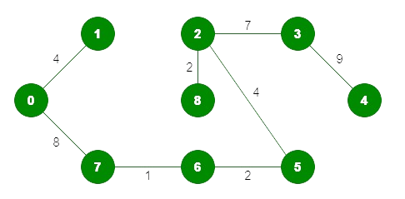
SPANNING TREE
COST: 1+2+2+4+4+7+8+9 = 37

Slide 16
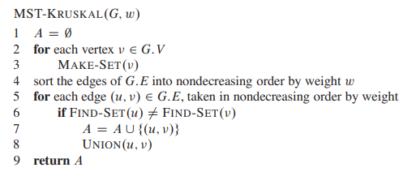
THE ALGORITHM

Slide 17
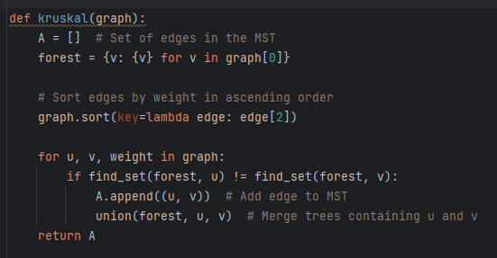

Slide 18
ANALYSIS
Algorithm runs on O(E LOG E) run-time of merge sort algorithm were E is the number of edges to be sorted.

